Slide 1
Forest Park Southeast, Botanical Heights, Central West End, Medical Campus
Monthly Crime Report: April 2020
Washington University Medical Center

Slide 2
Forest Park Southeast: Summary Notes
14 total crimes in April 2020
-22% change compared to April 2019 (18 total crimes)
0 crime(s) against persons in April 2020
-100% change compared to April 2019 (3 crimes against persons)
102 total crimes in 2020
50% change compared to this time in 2019 (68 total crimes)
17 crime(s) against persons in 2020
89% change compared to this time in 2019 (9 crimes against persons)

Slide 3
Forest Park Southeast: Year to Year Comparison
Part 1 Crimes | Jan | Feb | Mar | Apr | May | Jun | Jul | Aug | Sep | Oct | Nov | Dec | Total
Aggravated Assault | 0 | 3 | 1 | 2 | 2 | 4 | 2 | 0 | 2 | 5 | 0 | 5 | 26
Arson | 0 | 0 | 1 | 0 | 0 | 1 | 0 | 0 | 0 | 0 | 0 | 0 | 2
Burgalry | 0 | 0 | 1 | 1 | 0 | 0 | 3 | 1 | 4 | 8 | 3 | 1 | 22
Homicide | 0 | 0 | 0 | 0 | 0 | 0 | 0 | 0 | 1 | 0 | 0 | 0 | 1
Larceny | 7 | 10 | 15 | 12 | 9 | 21 | 17 | 19 | 24 | 35 | 17 | 32 | 218
Motor Vehicle Theft | 3 | 6 | 1 | 2 | 0 | 4 | 6 | 1 | 8 | 3 | 3 | 0 | 37
Robbery | 1 | 0 | 1 | 1 | 2 | 5 | 2 | 1 | 2 | 3 | 1 | 2 | 21
Total | 11 | 19 | 20 | 18 | 13 | 35 | 30 | 22 | 41 | 54 | 24 | 40 | 327
Part 1 Crimes | Jan | Feb | Mar | Apr | Total
Aggravated Assault | 1 | 5 | 3 | 0 | 9
Arson | 0 | 0 | 0 | 0 | 0
Burgalry | 3 | 1 | 4 | 1 | 9
Homicide | 0 | 0 | 0 | 0 | 0
Larceny | 25 | 15 | 14 | 10 | 64
Motor Vehicle Theft | 2 | 5 | 2 | 3 | 12
Robbery | 1 | 6 | 1 | 0 | 8
Total | 32 | 32 | 24 | 14 | 102

Slide 4
Forest Park Southeast: Summary Tables
Day of the Week | Number of Crimes
Sun | 2
Mon | 0
Tue | 0
Wed | 0
Thu | 4
Fri | 4
Sat | 4
Total | 14
Part 1 Crimes | Number of Crimes
Burgalry | 1
Larceny | 10
Motor Vehicle Theft | 3
Total | 14
Crimes Against Persons | Number of Crimes
FALSE | 14
Total | 14
Time of Day | Number of Crimes
Day | 14
Total | 14

Slide 5
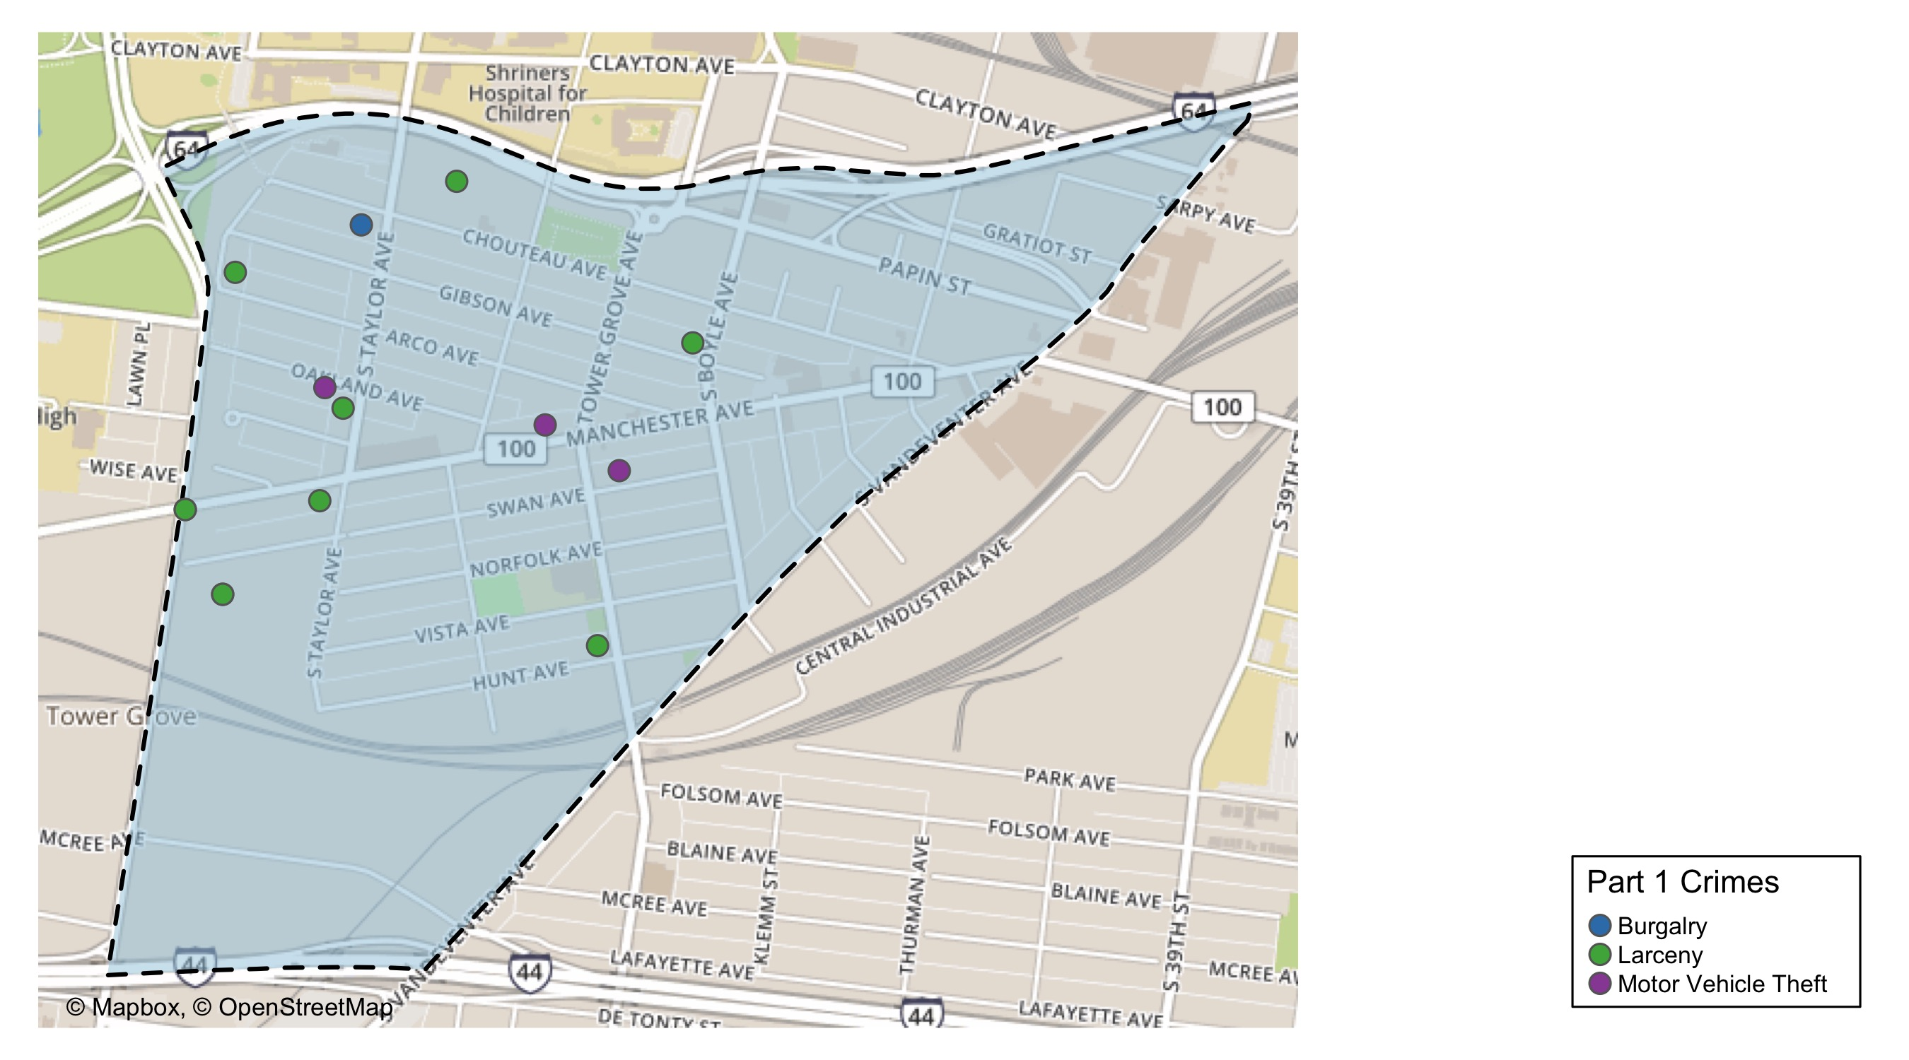
Forest Park Southeast: Total Crime Map

Slide 6
Botanical Heights: Summary Notes
3 total crimes in April 2020
-40% change compared to April 2019 (5 total crimes)
1 crime(s) against persons in April 2020
Inf change compared to April 2019 (0 crimes against persons)
19 total crimes in 2020
-24% change compared to this time in 2019 (25 total crimes)
4 crime(s) against persons in 2020
100% change compared to this time in 2019 (2 crimes against persons)

Slide 7
Botanical Heights: Year to Year Comparison
Part 1 Crimes | Jan | Feb | Mar | Apr | May | Jun | Jul | Aug | Sep | Oct | Nov | Dec | Total
Aggravated Assault | 0 | 0 | 0 | 0 | 4 | 0 | 0 | 1 | 0 | 0 | 2 | 1 | 8
Arson | 0 | 0 | 0 | 0 | 0 | 0 | 0 | 0 | 0 | 0 | 0 | 0 | 0
Burgalry | 2 | 0 | 0 | 2 | 0 | 0 | 1 | 1 | 3 | 0 | 1 | 2 | 12
Homicide | 0 | 0 | 0 | 0 | 0 | 0 | 0 | 0 | 0 | 0 | 0 | 0 | 0
Larceny | 2 | 3 | 6 | 3 | 3 | 3 | 9 | 1 | 5 | 4 | 3 | 5 | 47
Motor Vehicle Theft | 1 | 1 | 3 | 0 | 1 | 1 | 0 | 1 | 0 | 1 | 1 | 2 | 12
Robbery | 0 | 2 | 0 | 0 | 1 | 1 | 0 | 0 | 0 | 3 | 0 | 1 | 8
Total | 5 | 6 | 9 | 5 | 9 | 5 | 10 | 4 | 8 | 8 | 7 | 11 | 87
Part 1 Crimes | Jan | Feb | Mar | Apr | Total
Aggravated Assault | 1 | 0 | 0 | 1 | 2
Arson | 0 | 0 | 0 | 0 | 0
Burgalry | 1 | 0 | 1 | 0 | 2
Homicide | 1 | 0 | 0 | 0 | 1
Larceny | 2 | 6 | 2 | 2 | 12
Motor Vehicle Theft | 0 | 0 | 0 | 0 | 0
Robbery | 1 | 0 | 1 | 0 | 2
Total | 6 | 6 | 4 | 3 | 19

Slide 8
Botanical Heights: Summary Tables
Day of the Week | Number of Crimes
Sun | 0
Mon | 1
Tue | 1
Wed | 0
Thu | 0
Fri | 1
Sat | 0
Total | 3
Part 1 Crimes | Number of Crimes
Aggravated Assault | 1
Larceny | 2
Total | 3
Crimes Against Persons | Number of Crimes
FALSE | 2
TRUE | 1
Total | 3
Time of Day | Number of Crimes
Day | 3
Total | 3

Slide 9
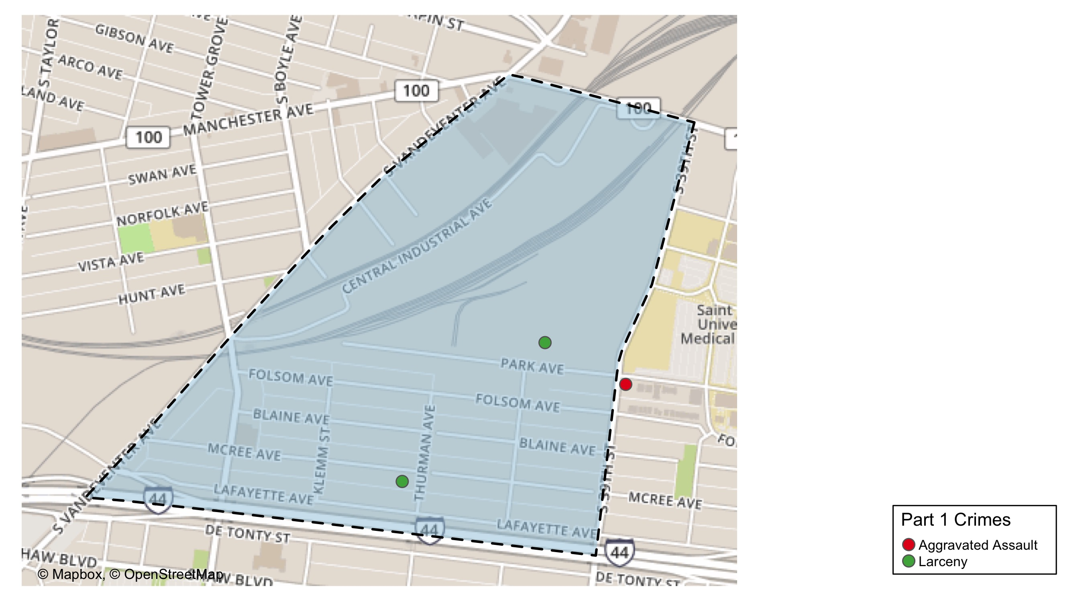
Botanical Heights: Total Crime Map

Slide 10
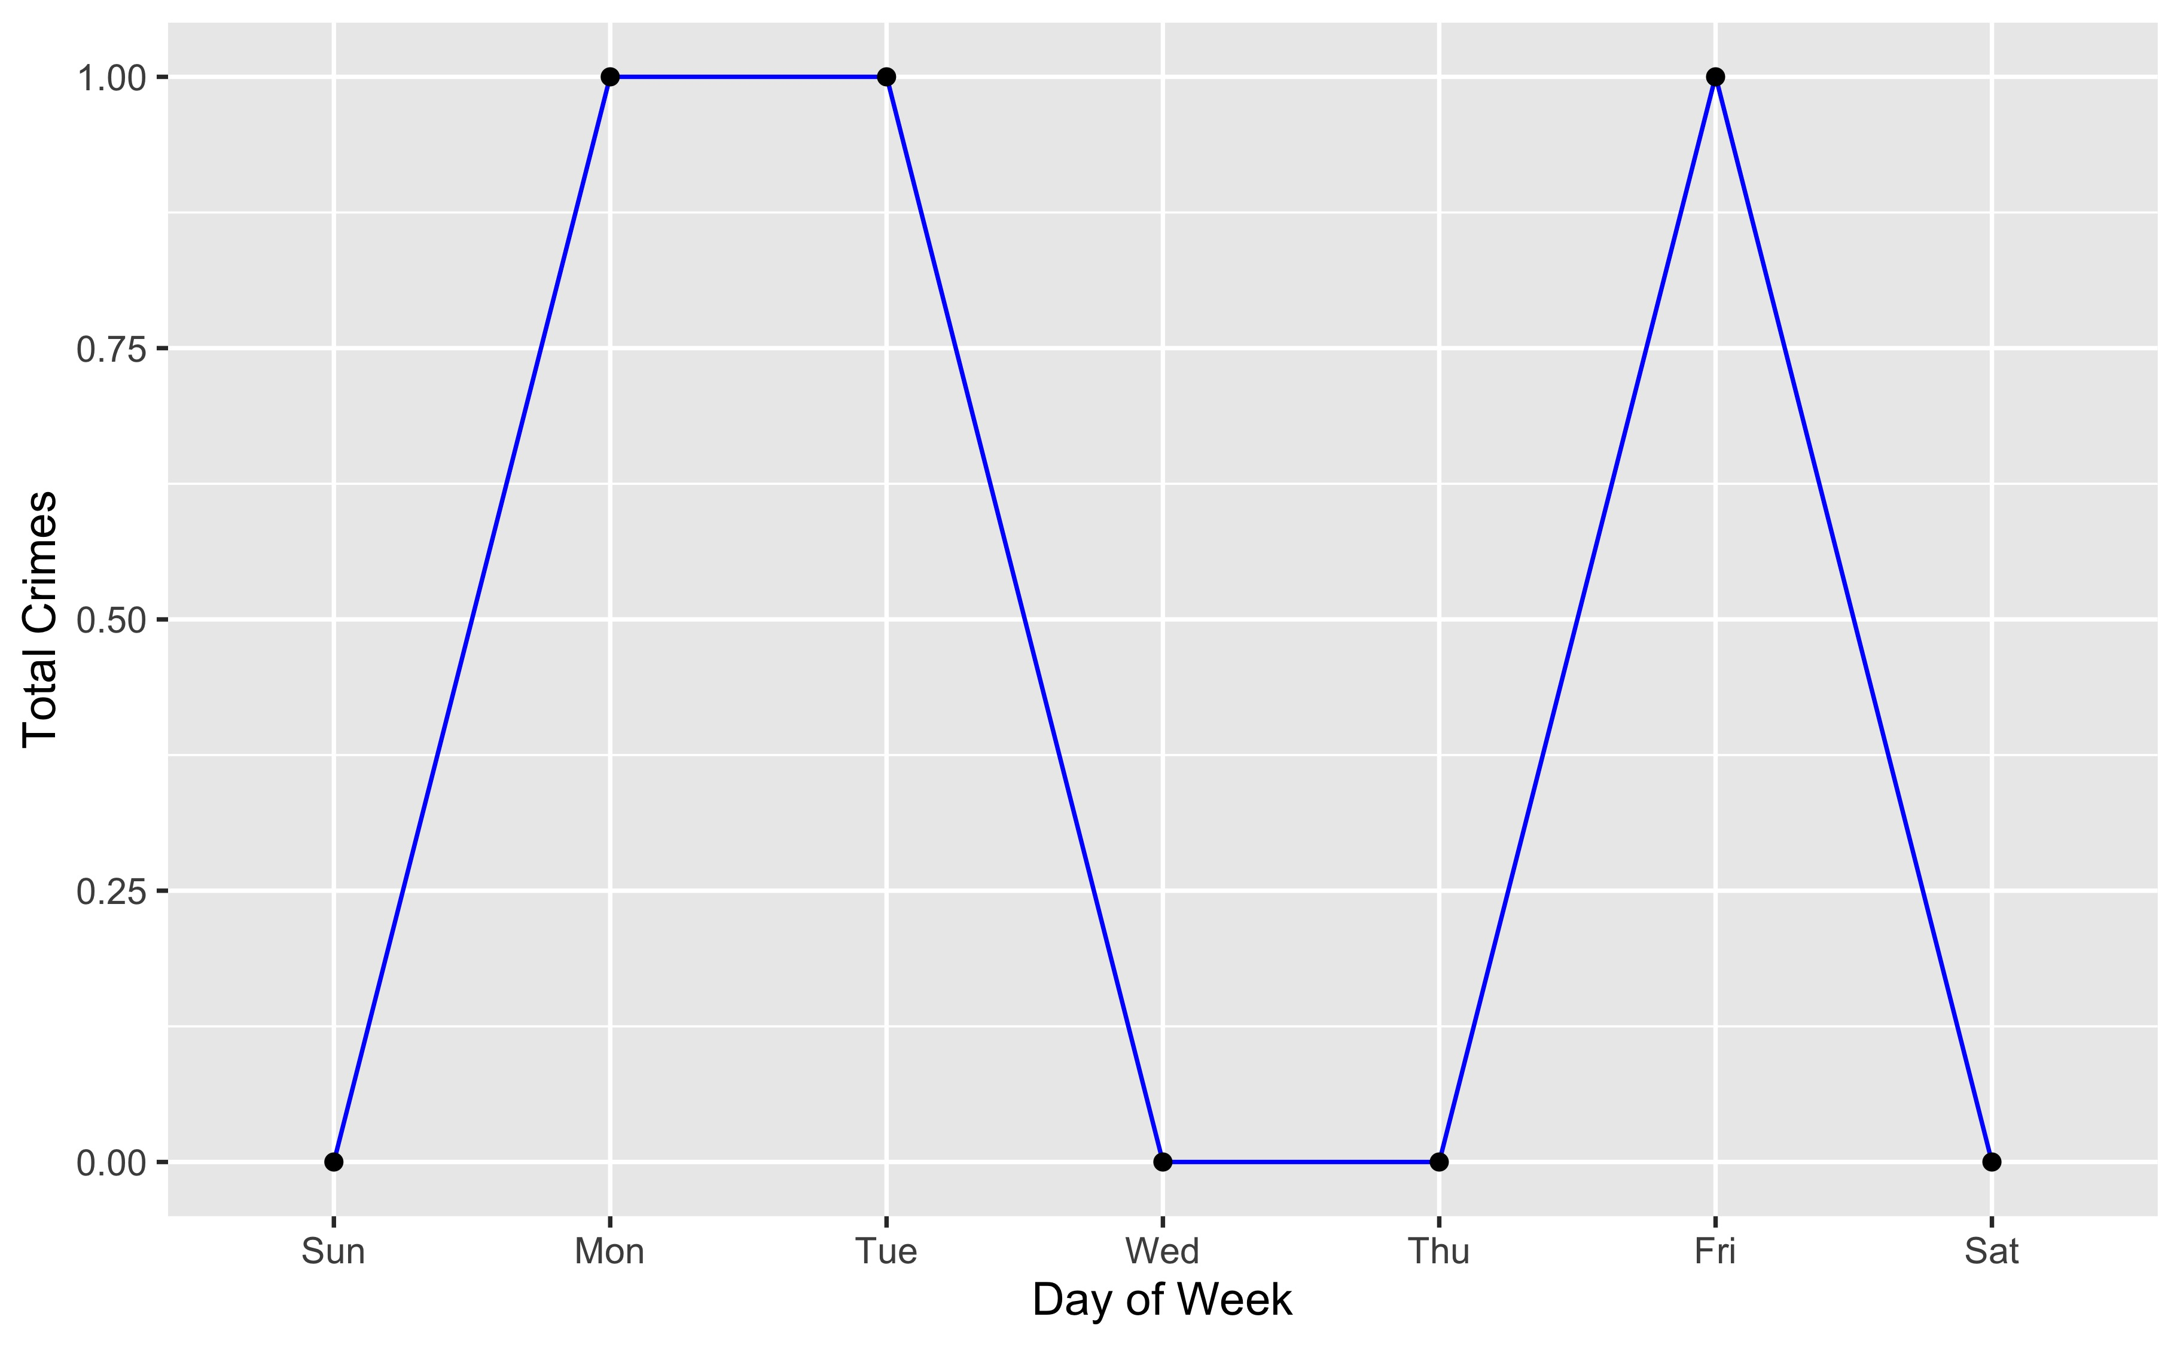
Botanical Heights: Crime by Days of the Week

Slide 11
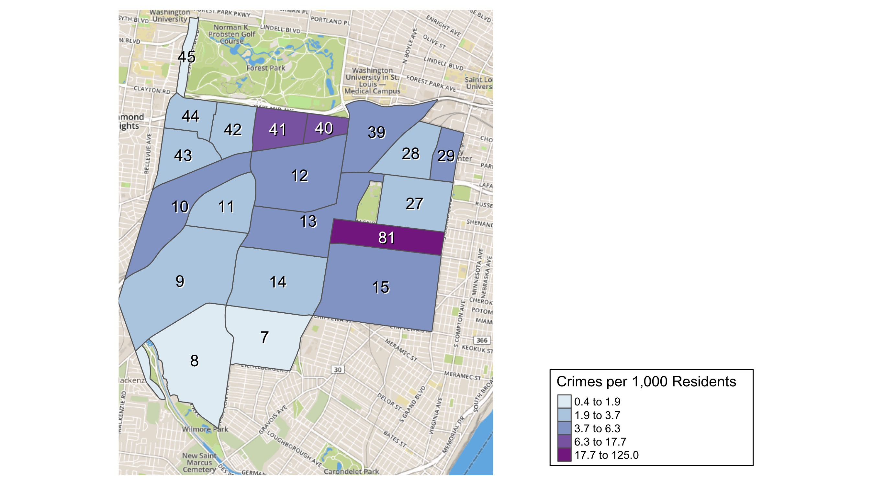
District 2: Crime Rates Map

Slide 12
District 2: Density Map Explanation
There are 23 neighborhoods in District 2. The South Hampton neighborhood is split between District 2 and District 1.
The minimum number of crimes in one neighborhood was 1 (Tower Grove Park)
The maximum number of crimes in one neighborhood was 60 (Tower Grove South)
The mean number of crimes in one neighborhood was 13.1
The minimum rate of crimes in one neighborhood was 0.43 (Southampton)
The maximum rate of crimes in one neighborhood was 125 (Tower Grove Park)
The mean rate of crimes in one neighborhood was 10.9

Slide 13
Central West End: Summary Notes
90 total crimes in April 2020
-3% change compared to April 2019 (93 total crimes)
8 crime(s) against persons in April 2020
0% change compared to April 2019 (8 crimes against persons)
321 total crimes in 2020
-5% change compared to this time in 2019 (339 total crimes)
44 crime(s) against persons in 2020
2% change compared to this time in 2019 (43 crimes against persons)

Slide 14
Central West End: Year to Year Comparison
Part 1 Crimes | Jan | Feb | Mar | Apr | May | Jun | Jul | Aug | Sep | Oct | Nov | Dec | Total
Aggravated Assault | 9 | 4 | 10 | 2 | 8 | 13 | 4 | 11 | 3 | 8 | 4 | 11 | 87
Arson | 0 | 0 | 1 | 0 | 0 | 0 | 0 | 0 | 0 | 0 | 0 | 0 | 1
Burgalry | 3 | 5 | 5 | 9 | 13 | 8 | 13 | 18 | 8 | 8 | 10 | 5 | 105
Homicide | 0 | 0 | 0 | 0 | 0 | 0 | 0 | 0 | 0 | 0 | 0 | 0 | 0
Larceny | 45 | 66 | 65 | 65 | 72 | 56 | 75 | 81 | 63 | 90 | 89 | 65 | 832
Motor Vehicle Theft | 11 | 7 | 3 | 11 | 12 | 9 | 5 | 11 | 9 | 5 | 19 | 9 | 111
Robbery | 5 | 5 | 2 | 6 | 7 | 3 | 4 | 8 | 3 | 8 | 11 | 10 | 72
Total | 73 | 87 | 86 | 93 | 112 | 89 | 101 | 129 | 86 | 119 | 133 | 100 | 1,208
Part 1 Crimes | Jan | Feb | Mar | Apr | Total
Aggravated Assault | 3 | 5 | 3 | 6 | 17
Arson | 0 | 0 | 0 | 0 | 0
Burgalry | 6 | 4 | 4 | 6 | 20
Homicide | 1 | 0 | 0 | 0 | 1
Larceny | 53 | 53 | 52 | 62 | 220
Motor Vehicle Theft | 5 | 7 | 10 | 14 | 36
Robbery | 12 | 8 | 5 | 2 | 27
Total | 80 | 77 | 74 | 90 | 321

Slide 15
Central West End: Summary Tables
Day of the Week | Number of Crimes
Sun | 9
Mon | 11
Tue | 11
Wed | 19
Thu | 13
Fri | 13
Sat | 14
Total | 90
Part 1 Crimes | Number of Crimes
Aggravated Assault | 6
Burgalry | 6
Larceny | 62
Motor Vehicle Theft | 14
Robbery | 2
Total | 90
Crimes Against Persons | Number of Crimes
FALSE | 82
TRUE | 8
Total | 90
Time of Day | Number of Crimes
Day | 80
Night | 10
Total | 90

Slide 16
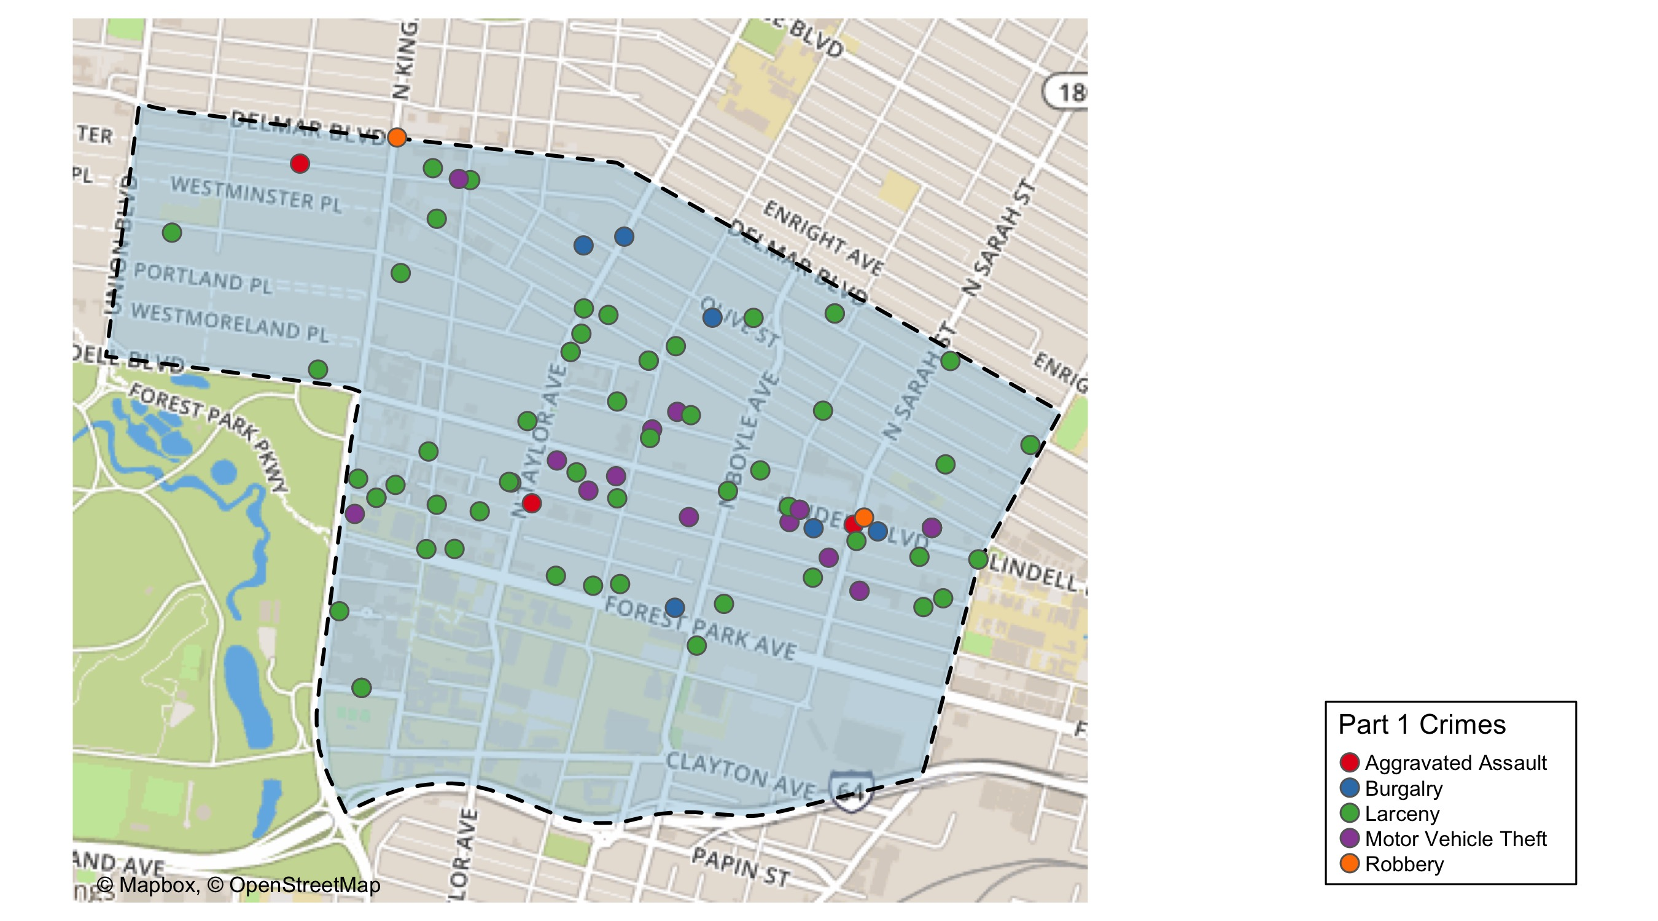
Central West End: Total Crime Map

Slide 17
Washington University Medical Campus: Summary Notes
5 total crimes in April 2020
-58% change compared to April 2019 (12 total crimes)
1 crime(s) against persons in April 2020
0% change compared to April 2019 (1 crimes against persons)
30 total crimes in 2020
-29% change compared to this time in 2019 (42 total crimes)
7 crime(s) against persons in 2020
0% change compared to this time in 2019 (7 crimes against persons)

Slide 18
Forest Park Southeast: Year to Year Comparison
Part 1 Crimes | Jan | Feb | Mar | Apr | May | Jun | Jul | Aug | Sep | Oct | Nov | Dec | Total
Aggravated Assault | 4 | 1 | 1 | 0 | 0 | 2 | 0 | 5 | 3 | 0 | 1 | 0 | 17
Arson | 0 | 0 | 0 | 0 | 0 | 0 | 0 | 0 | 0 | 0 | 0 | 0 | 0
Burgalry | 0 | 0 | 0 | 0 | 0 | 0 | 0 | 1 | 0 | 0 | 0 | 0 | 1
Homicide | 0 | 0 | 0 | 0 | 0 | 0 | 0 | 0 | 0 | 0 | 0 | 0 | 0
Larceny | 7 | 8 | 6 | 9 | 9 | 6 | 8 | 4 | 11 | 6 | 10 | 10 | 94
Motor Vehicle Theft | 2 | 0 | 1 | 2 | 1 | 0 | 0 | 1 | 2 | 0 | 4 | 2 | 15
Robbery | 0 | 0 | 0 | 1 | 0 | 1 | 0 | 1 | 1 | 1 | 2 | 0 | 7
Total | 13 | 9 | 8 | 12 | 10 | 9 | 8 | 12 | 17 | 7 | 17 | 12 | 134
Part 1 Crimes | Jan | Feb | Mar | Apr | Total
Aggravated Assault | 0 | 0 | 2 | 1 | 3
Arson | 0 | 0 | 0 | 0 | 0
Burgalry | 1 | 0 | 0 | 0 | 1
Homicide | 0 | 0 | 0 | 0 | 0
Larceny | 8 | 5 | 4 | 3 | 20
Motor Vehicle Theft | 0 | 1 | 0 | 1 | 2
Robbery | 1 | 3 | 0 | 0 | 4
Total | 10 | 9 | 6 | 5 | 30

Slide 19
Washington University Medical Campus: Summary Tables
Part 1 Crimes | Number of Crimes
Aggravated Assault | 1
Larceny | 3
Motor Vehicle Theft | 1
Total | 5
Type of Larceny | Number of Crimes
From Building | 1
From Coin Machine | 1
From Motor Vehicle | 1
Total | 3
Time of Day | Number of Crimes
Day | 2
Night | 3
Total | 5
Monetary Value | Number of Crimes
Under $500 | 3
Total | 3

Slide 20
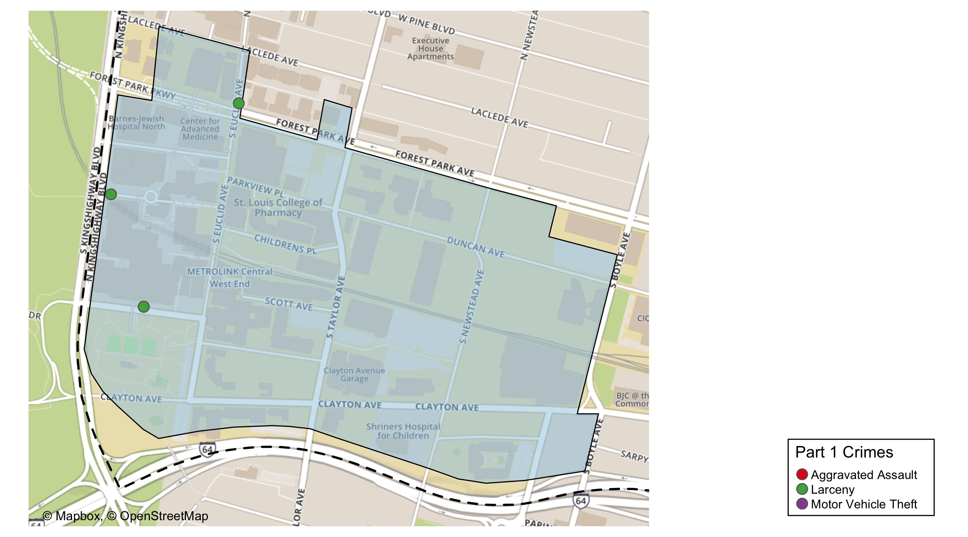
Washington University Medical Center: Total Crime Map

Slide 21
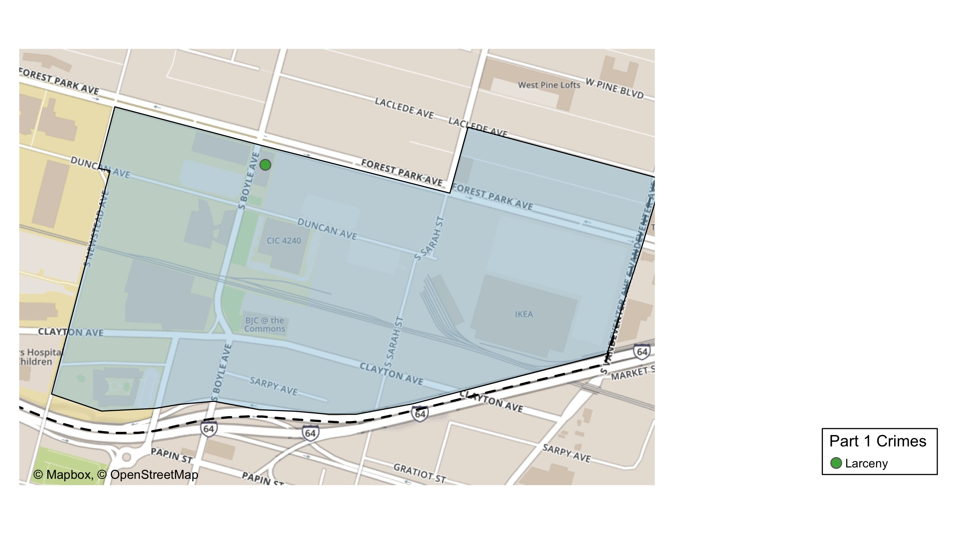
Cortex: Total Crime Map

Slide 22
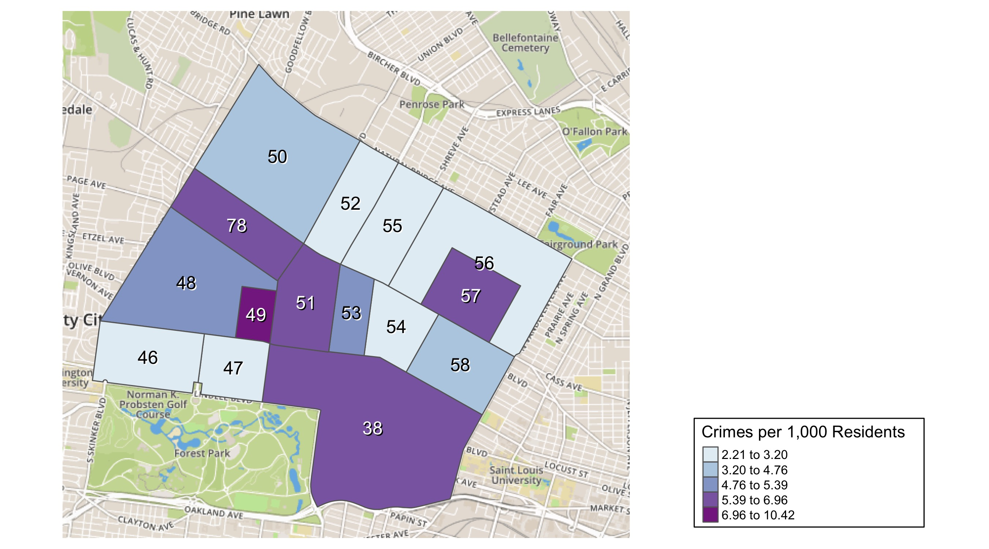
District 5: Crime Rates Map

Slide 23
District 5: Density Map Explanation
There are 15 neighborhoods in District 5
The minimum number of crimes in one neighborhood was 4 (Lewis Place)
The maximum number of crimes in one neighborhood was 90 (Central West End)
The mean number of crimes in one neighborhood was 19
The minimum rate of crimes in one neighborhood was 2.21 (Skinker DeBaliviere)
The maximum rate of crimes in one neighborhood was 10.42 (Visitation Park)
The mean rate of crimes in one neighborhood was 4.79

Slide 24
Forest Park Southeast: Neighborhood Detail
Appendix 1

Slide 25
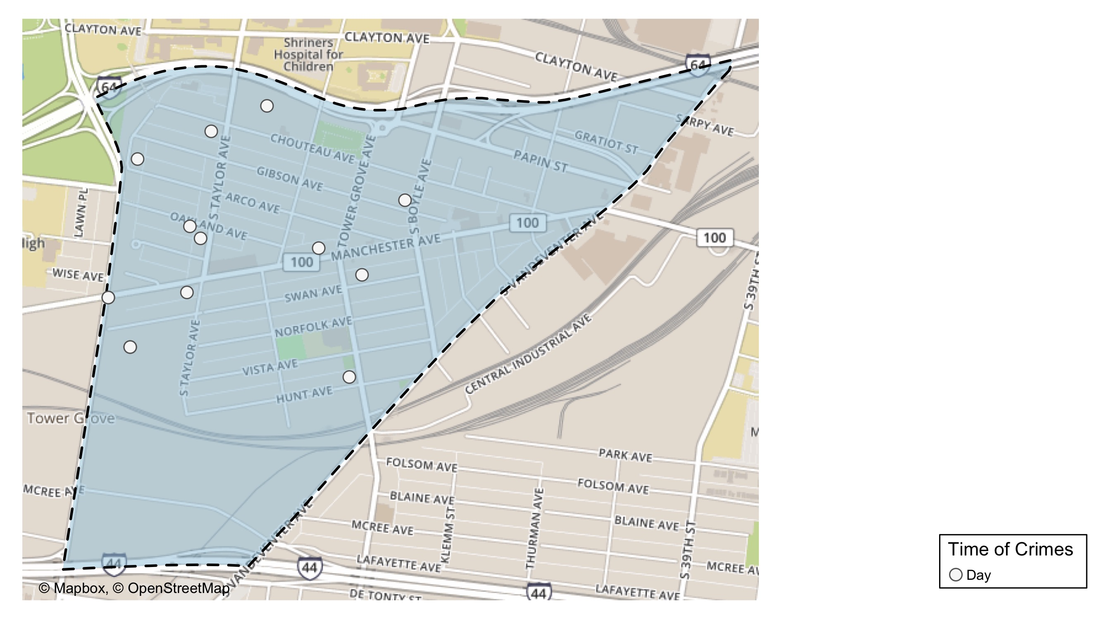
Forest Park Southeast: Time of Crimes Map

Slide 26
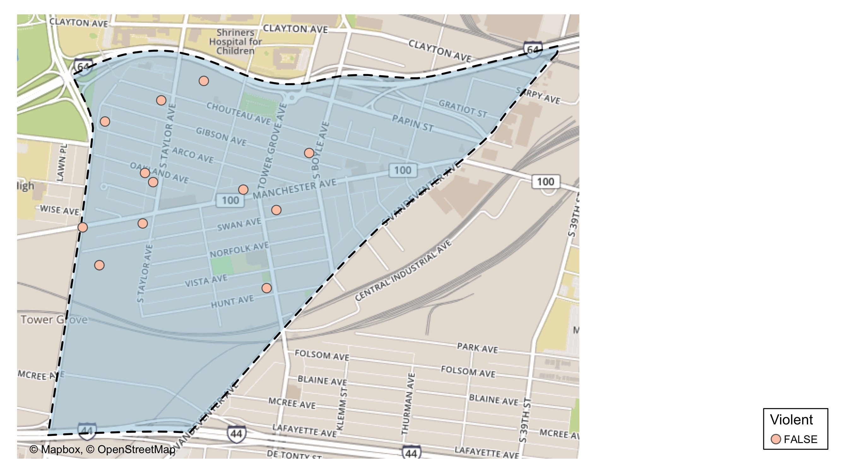
Forest Park Southeast: Violent Crime Map

Slide 27
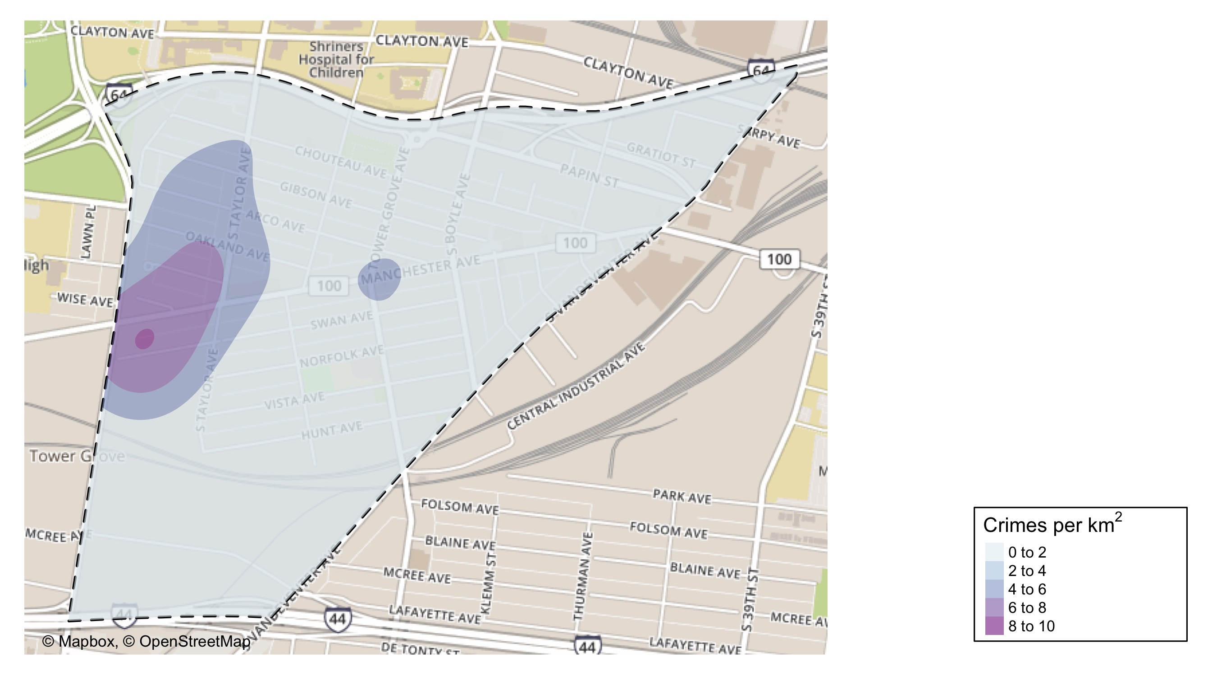
Forest Park Southeast: Crime Density Map

Slide 28
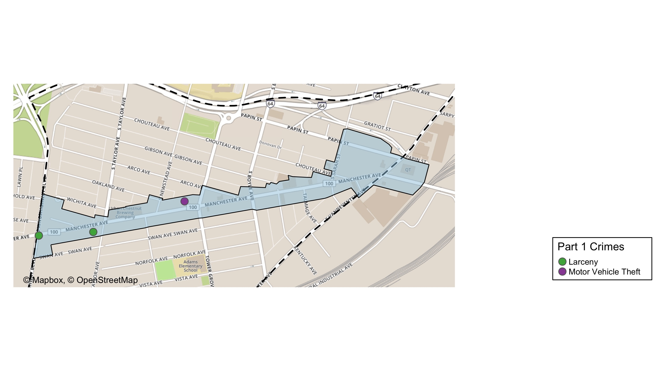
Grove Community Improvement District: Total Crime Map

Slide 29
Forest Park Southeast: Larceny Breakdown
Day of the Week | Number of Crimes
Sun | 1
Mon | 0
Tue | 0
Wed | 0
Thu | 2
Fri | 4
Sat | 3
Total | 10
Type of Larceny | Number of Crimes
All Other | 3
From Motor Vehicle | 3
Motor Vehicle Parts | 4
Total | 10
Time of Day | Number of Crimes
Day | 10
Total | 10
Monetary | Number of Crimes
$500 - $24,999 | 5
Under $500 | 5
Total | 10

Slide 30
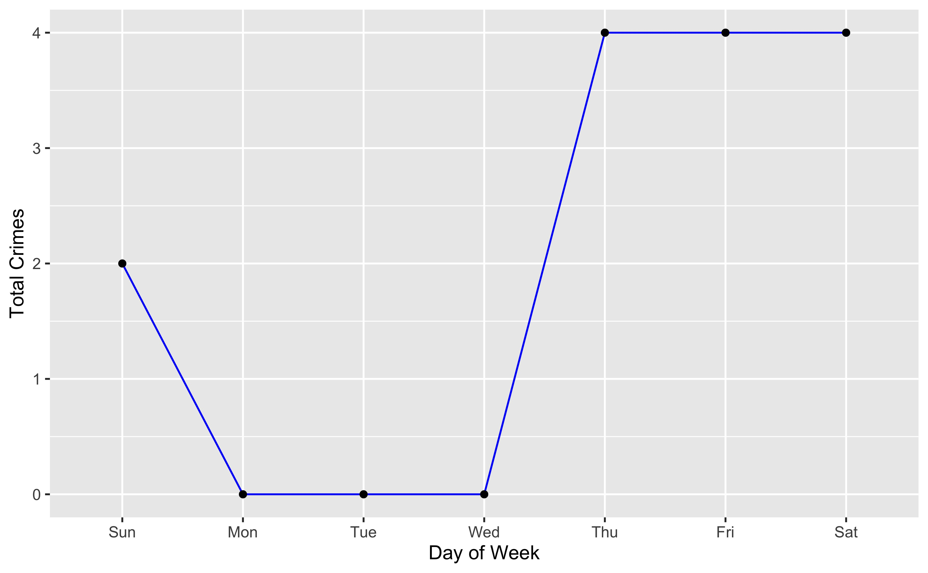
Forest Park Southeast: Total Crimes by Days of the Week

Slide 31
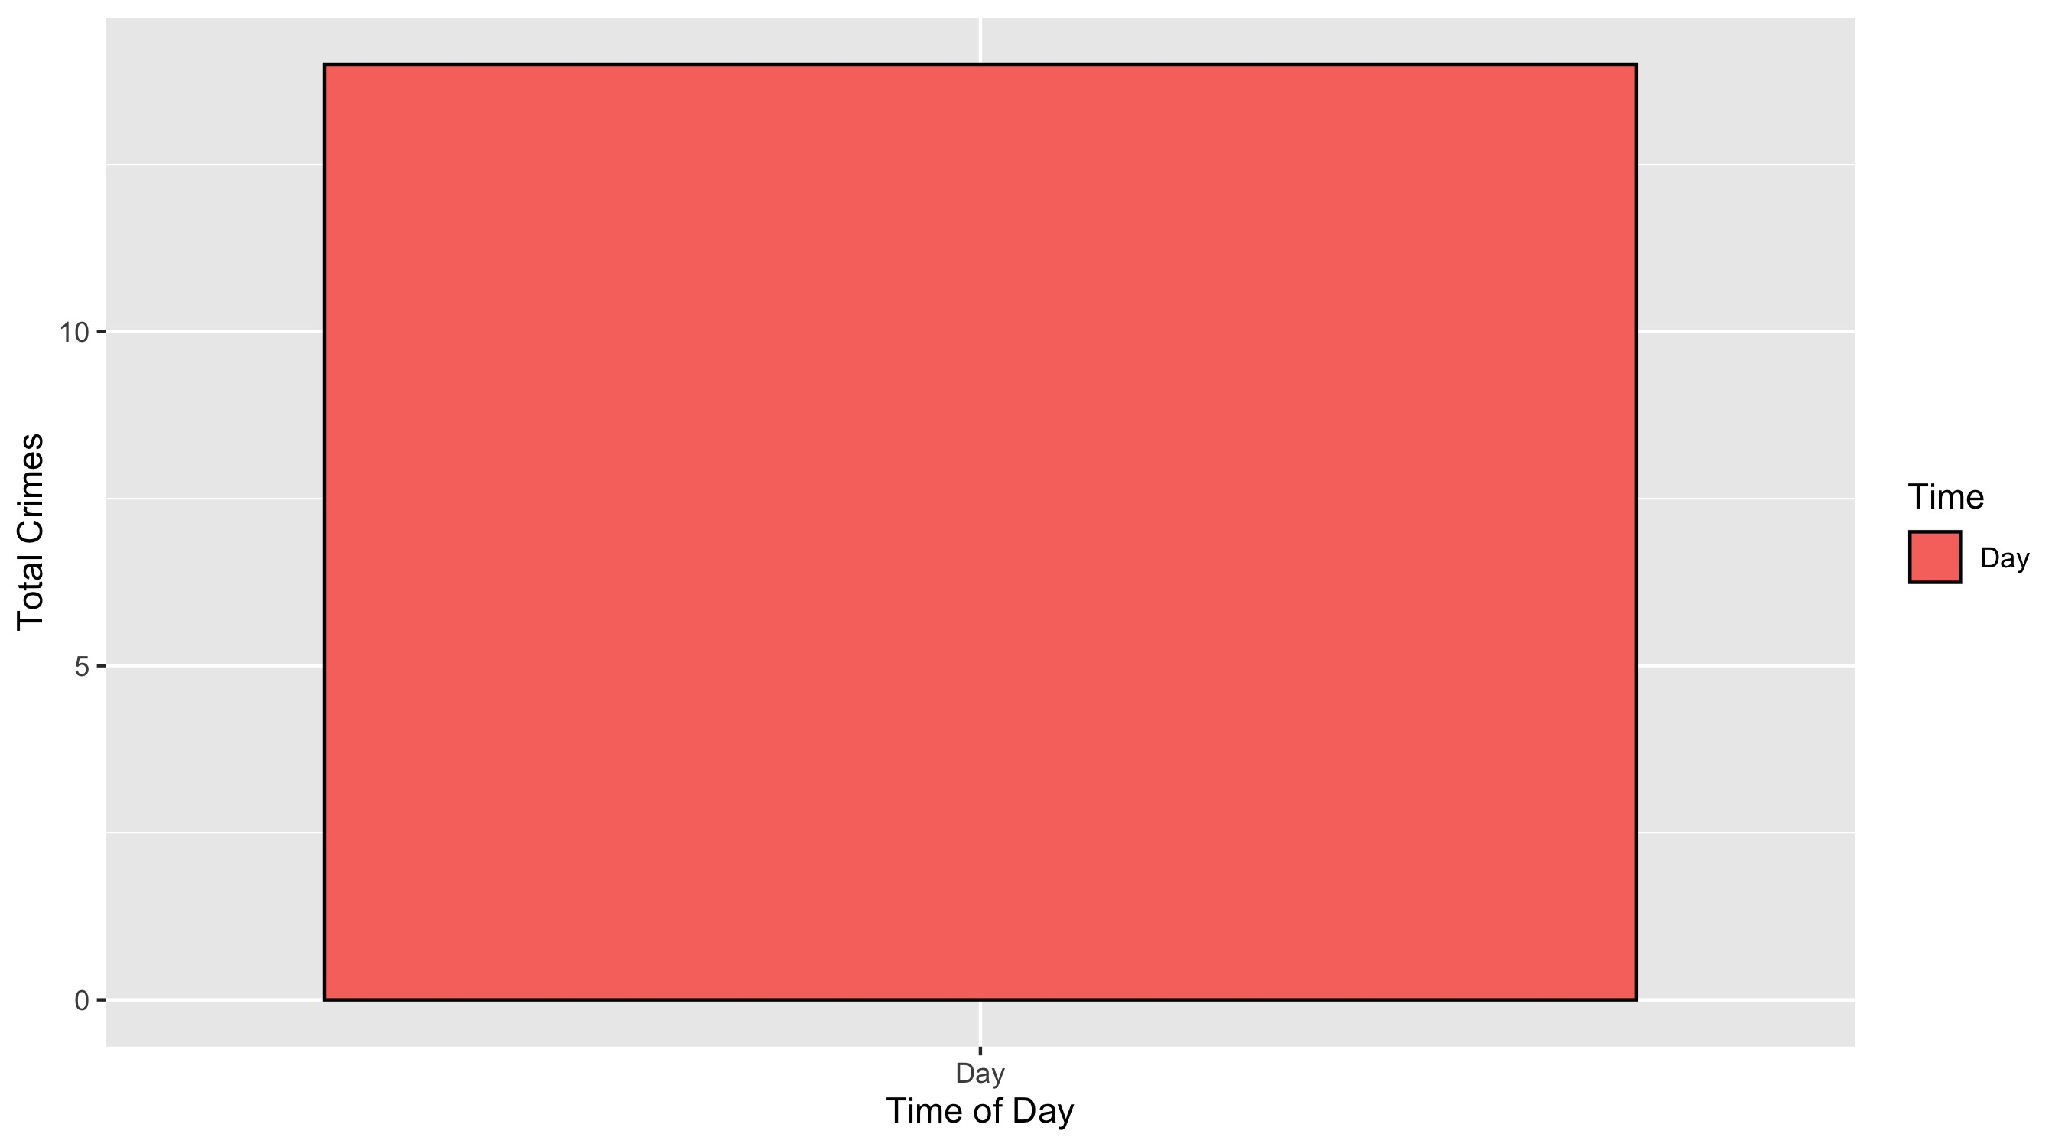
Forest Park Southeast: Crimes by Time of Day

Slide 32
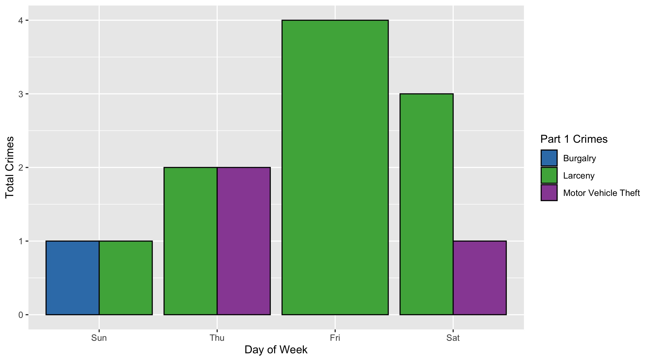
Forest Park Southeast: Crimes by Day & Category

Slide 33
Central West End: Neighborhood Detail
Appendix 2

Slide 34
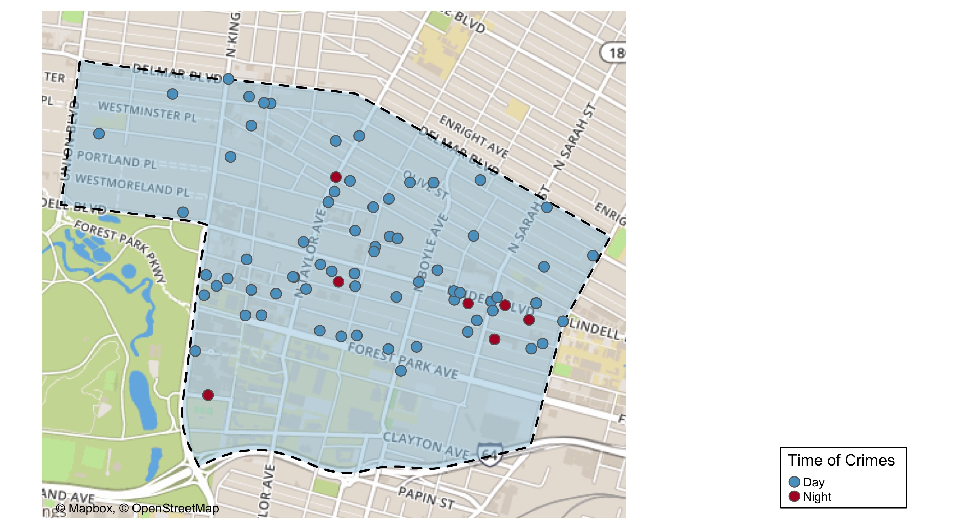
Central West End: Time of Crime Map

Slide 35
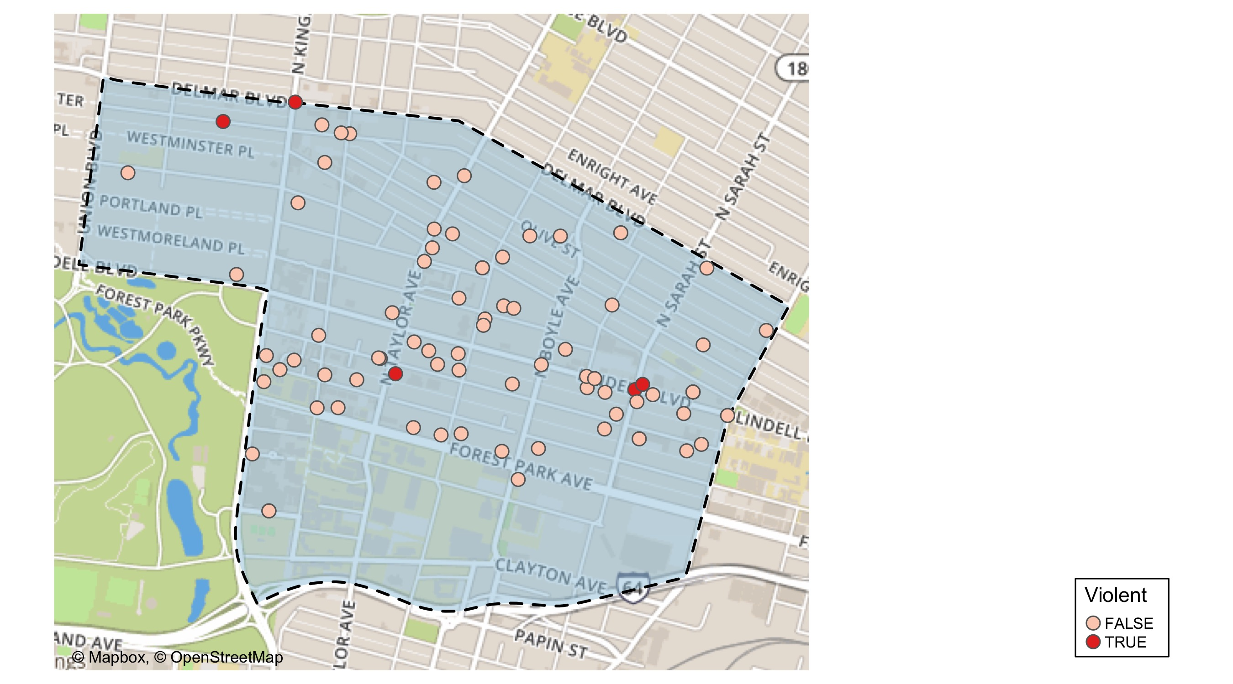
Central West End: Violent Crime Map

Slide 36
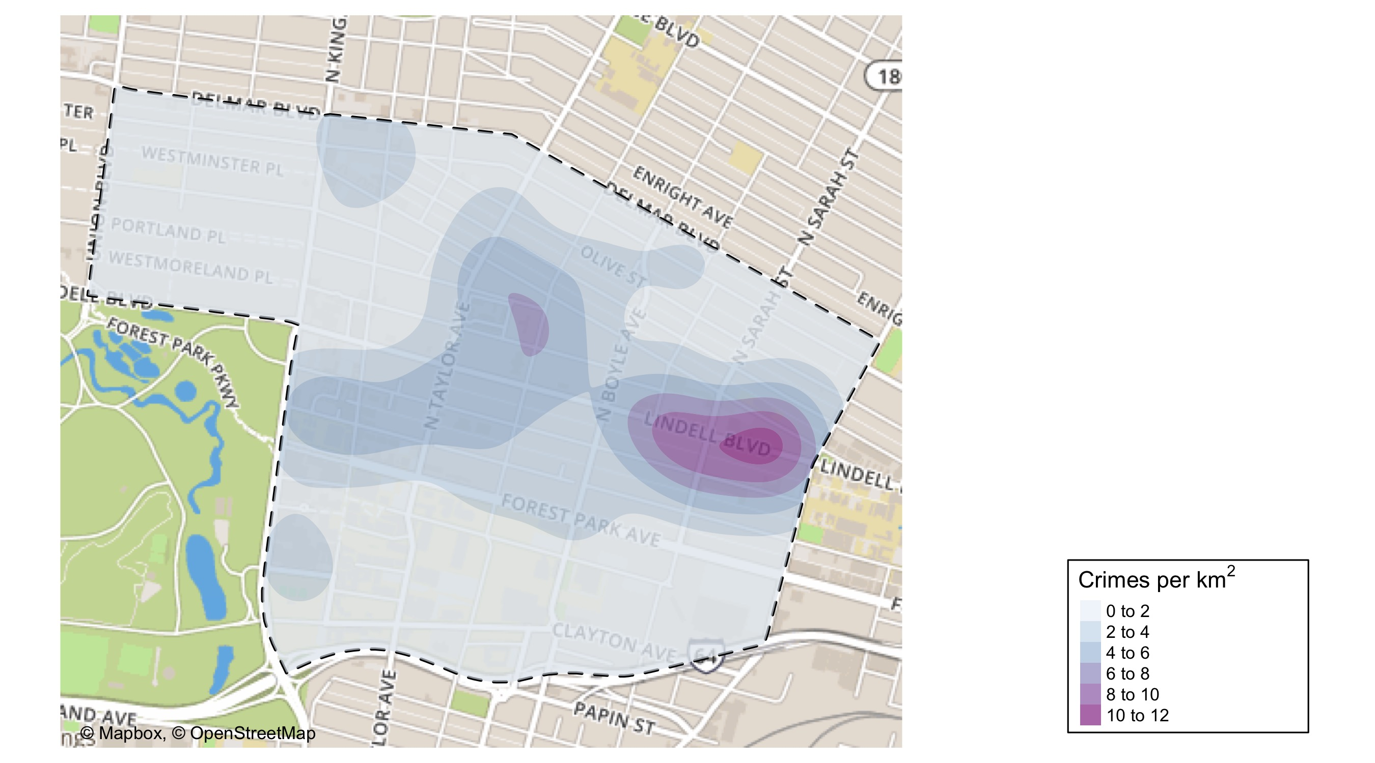
Central West End: Crime Density Map

Slide 37
Central West End: Larceny Breakdown
Day of the Week | Number of Crimes
Sun | 7
Mon | 6
Tue | 7
Wed | 16
Thu | 8
Fri | 8
Sat | 10
Total | 62
Type of Larceny | Number of Crimes
All Other | 9
Bicycle | 1
From Building | 5
From Coin Machine | 1
From Motor Vehicle | 32
Motor Vehicle Parts | 11
Shoplifting | 3
Total | 62
Time of Day | Number of Crimes
Day | 58
Night | 4
Total | 62
Monetary Value | Number of Crimes
$500 - $24,999 | 11
Under $500 | 51
Total | 62

Slide 38
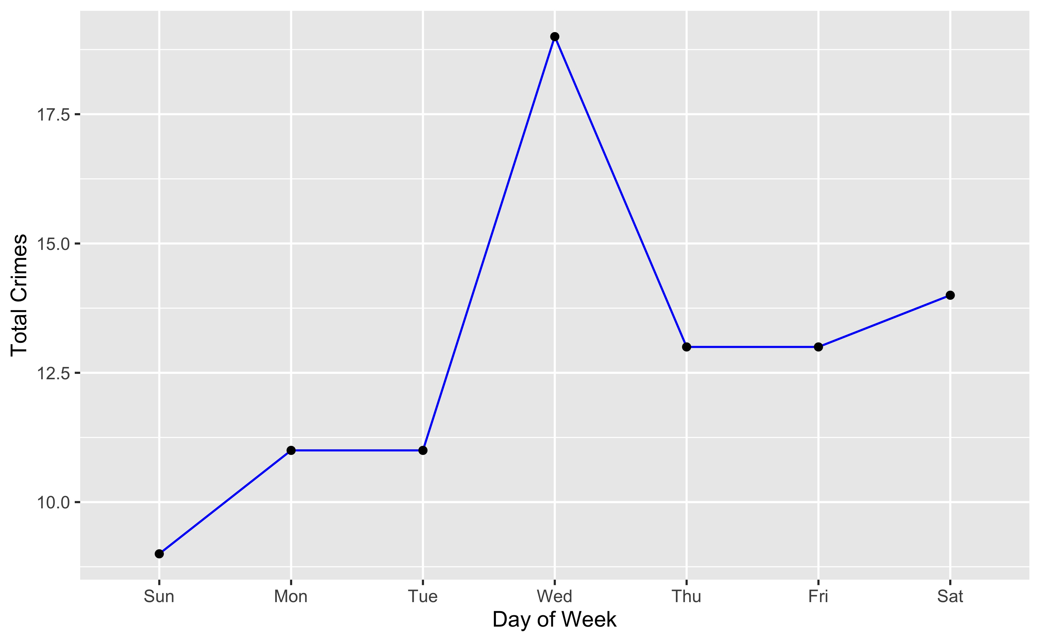
Central West End: Total Crimes by Days of the Week

Slide 39
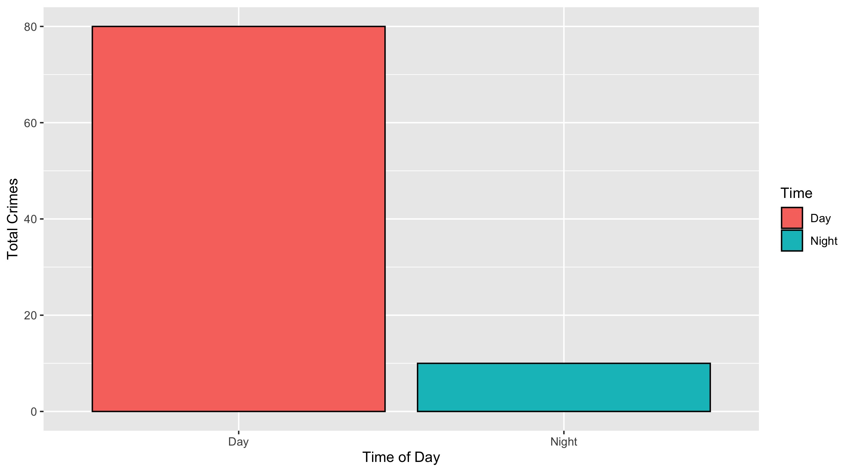
Central West End: Crimes by Time of Day

Slide 40
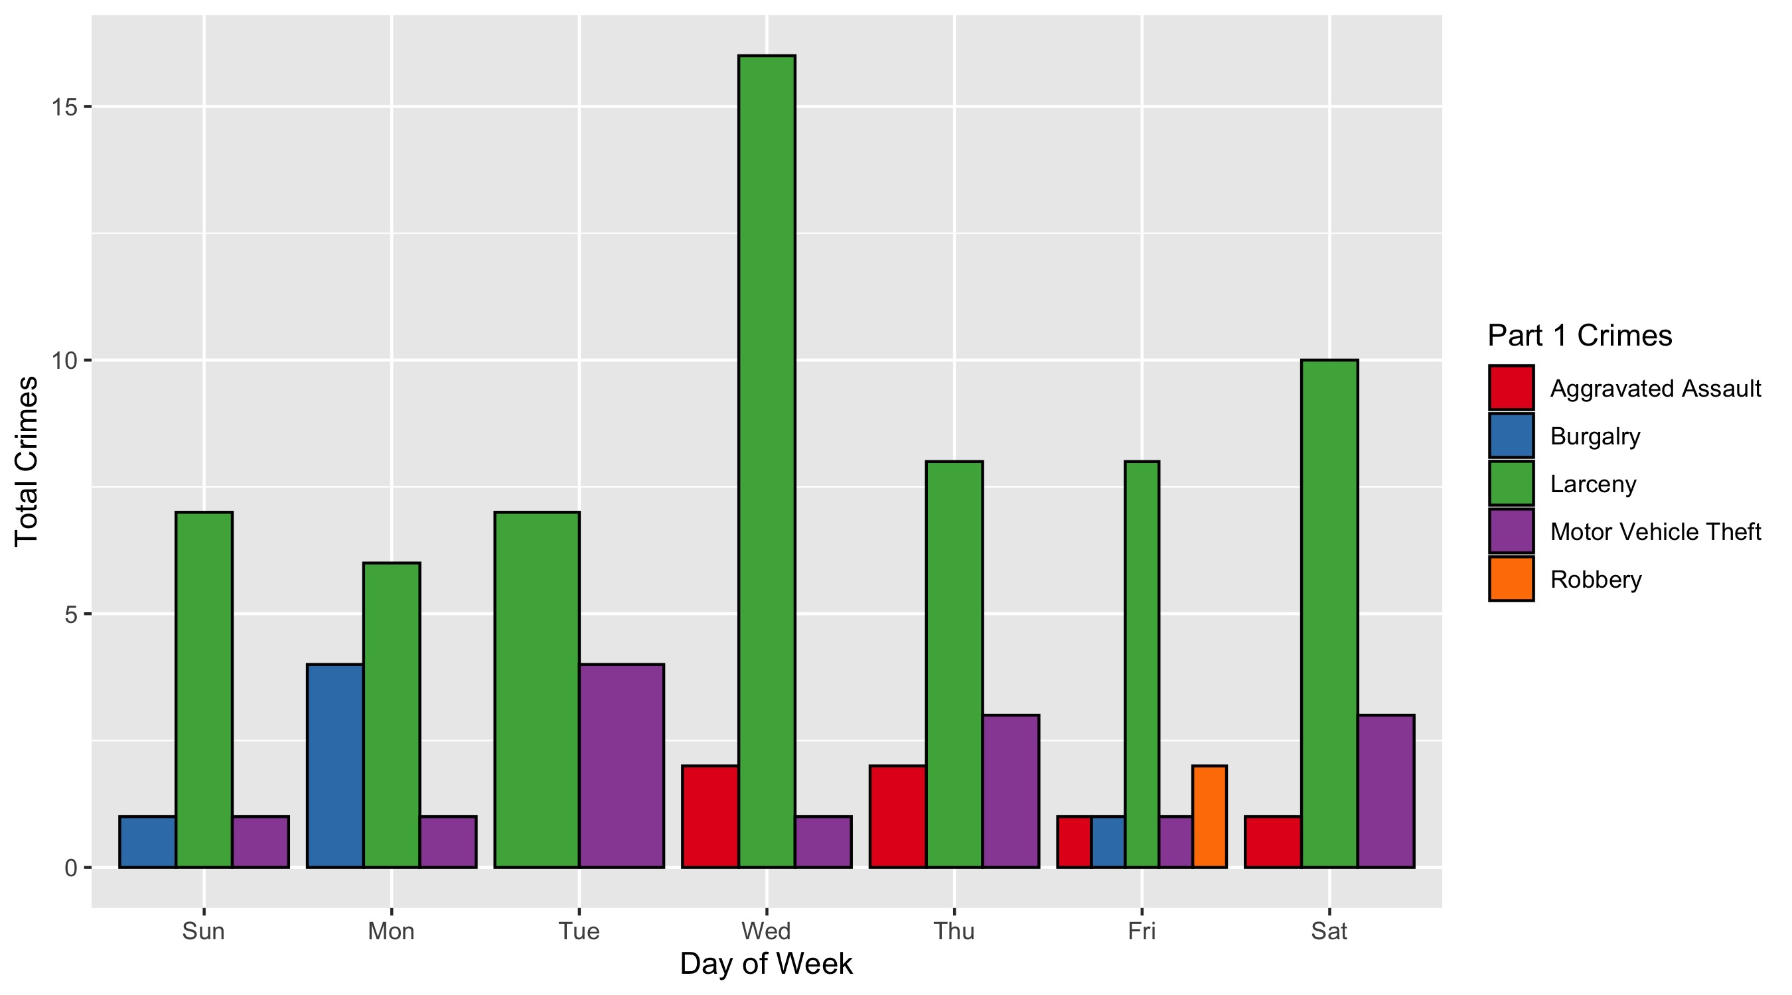
Central West End: Crimes by Day & Category

